Slide 1


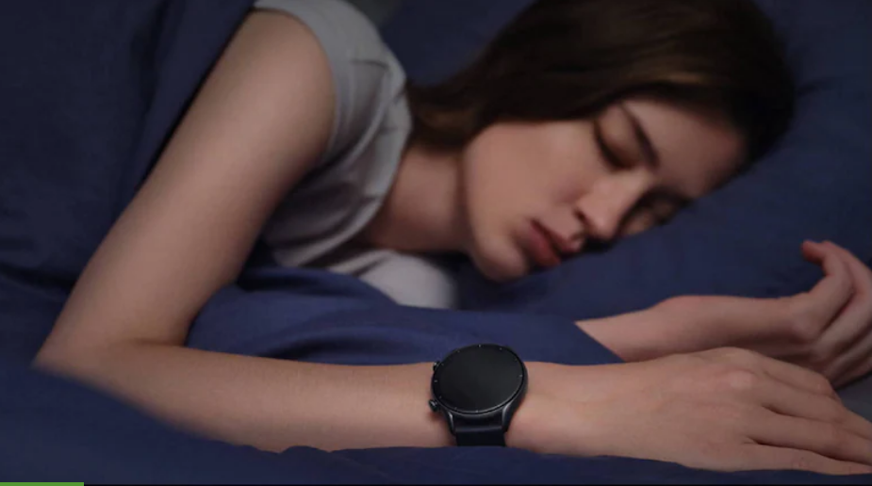
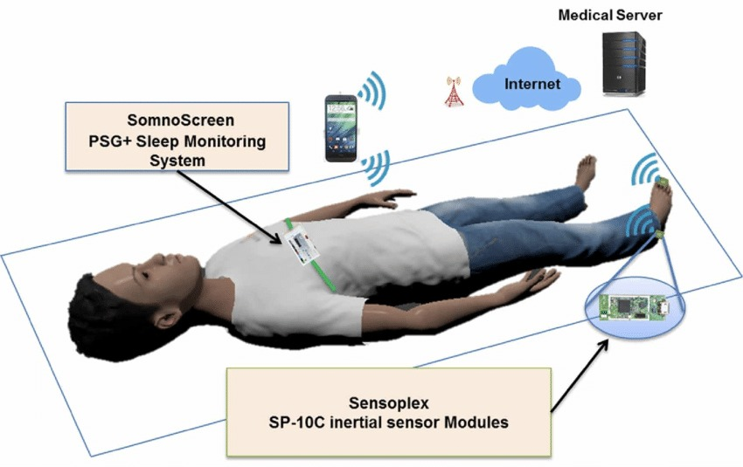
SLEEP MONITORING SYSTEM
Fundamentals of Innovation and Venture Development in Entrepreneurship
(21PC3ED58)
BACHELOR OF TECHNOLOGY
IN
COMPUTER ENGINEERING
(SOFTWARE ENGINEERING)
Faculty of Engineering & Technology
Jain (Deemed-To-Be University)
Department of Computer Science & Technology
Submitted by :
SACHIN SINGH
20BTRCS170
AAYUSHMA THAPA
20BTRSE072
MANISH YADAV
20BTRSE037
Under the guidance of
Mr. Santhosh S
PRIYANKA KUMARI
20BTRCO072
PREETI KURMI
20BTRCO071

Slide 2
indices
Keywords
Abstract
Problem definition
Introduction
Objective
Methodology , Hardware and Software tools used
Literature Survey
Related Work
Existing System
Limitation of Existing System
Market Survey
Proposed system
System Design
Implementation
Conclusion
References

Slide 3
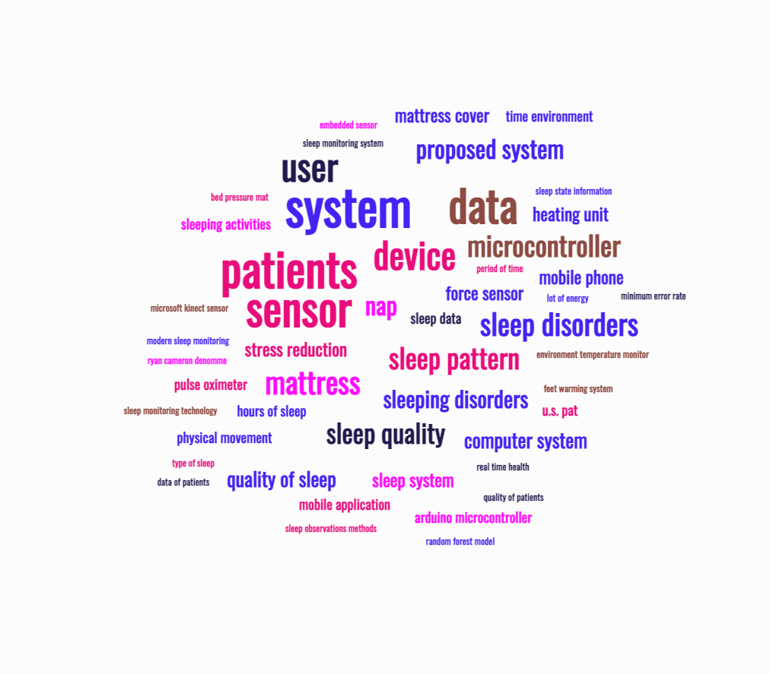
Keywords

Slide 4
Abstract
Sleep is a crucial aspect of overall health and well-being, and many people struggle to get enough high-quality sleep. To help individuals improve their sleep quality, we propose a sleep monitoring system that uses a smartwatch and machine learning algorithms. This system collects data on sleep duration, sleep quality, heart rate, and other physiological factors, which are analyzed using machine learning algorithms to provide personalized insights and recommendations for improving sleep. These recommendations could include adjustments to sleep schedules, changes to sleep hygiene practices, or dietary changes that can improve sleep. By providing personalized recommendations tailored to each individual's unique sleep patterns and physiological factors, this system has the potential to be a powerful tool for improving sleep quality and overall health. With the increasing popularity of wearable technology and the growing demand for personalized health solutions, a sleep monitoring system that uses a smartwatch and machine learning algorithms could be a valuable tool for individuals looking to improve their sleep quality and overall well-being.

Slide 5
Problem definition
A serious health problem that a sizable portion of the population faces is inadequate sleep. Obesity, diabetes, hypertension, melancholy, and anxiety are just a few of the physical and mental health issues that can result from getting too little sleep. Many people find it difficult to comprehend their sleep patterns and implement significant changes to enhance their sleep. People can track their sleep and receive individualized recommendations for improvement with the use of a sleep monitoring system that uses a smartwatch and machine learning.
The answer is to create a sleep monitoring system that employs a smartwatch to gather information about a user's sleep patterns and machine learning algorithms to analyze the information and offer individualized insights and suggestions. The system will monitor a number of sleep metrics, including REM sleep, sleep length, and quality, and utilize this information to produce a sleep score. Once the sleep score has been analyzed, the system will give users information about their sleeping habits, including when they are most likely to wake up, how often they wake up during the night, and how much deep and REM sleep they are obtaining. The system would offer the user personalized suggestions for enhancing their sleep based on this data, such as altering their sleep routine, boosting

Slide 6
Introduction
Sleeping is the need of the human body for their survivals and allows the user to remain fresh.
There are many benefits which user gets while having the sufficient sleep which includes sleep keep heart healthy, prevent cancer, reduces stress, reduces inflammation, makes you more alert, improves your memory, help you lose weight, makes you smarter.
In the past, some methods using Electroencephalograms (EEG) or Electromyograms (EMG) have been proposed for sleep disorder monitoring. However, these methods are very inconvenient for the patients due to the cumbersome wiring that is required for the bio signal acquisition.
The system which we implement will senses the activities whether we are sleeping in a right posture or not it detects our daily sleeping routines. It will monitor the sleeping activity of a person and will provide feedback that will help person in improving quality of sleep.

Slide 7
objectives
Understanding individual sleep
Reduce the chances of Insomnia.
Develop a that will sense the blood oxygen levels, hand and body movement while sleeping.
Develop a mobile application to keep track of their sleeping
Upgrading the monitoring system, to detect the time of sleeping, posture of sleeping and our sleep quality.
The device will monitor the sleeping activity of a person and will provide the feedback that will help person in improving quality of sleep.

Slide 8
Methodology
When a person is sleeping, their hand is connected to a wearable smartwatch called a Sleep Monitoring Device. Our body temperature and blood pressure drop as we sleep as the physiological demands are reduced.
The majority of our physiological functions, such as heart rate, breathing, and brain wave activity, are very predictable during non-REM sleep but fairly changeable when we are awake or during REM sleep.
Periodically throughout the night, REM sleep occurs, which is characterized by rapid eye movement, increased bodily activity while dreaming, a faster heartbeat, and shallower breathing.
Non-REM sleep is a relaxed state of sleep characterized by low levels of autonomic physiological activity, delta wave brain activity, and dreaming. It always happens during a typical sleep cycle.
So, with the help of sleep monitoring device, we are going to measure different aspect of REM sleep.

Slide 9
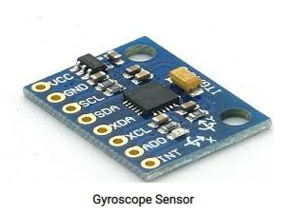
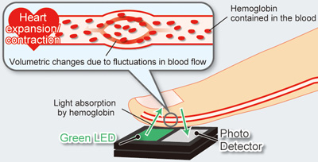
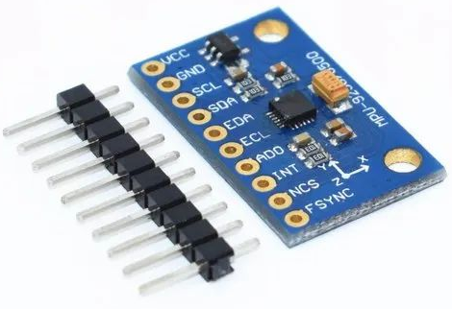
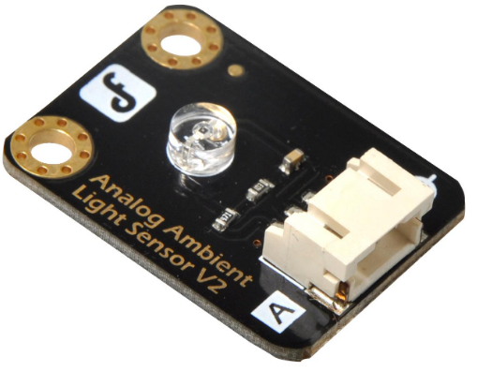
hardware
Optical heart rate sensor
An optical heart rate sensor measures pulse waves, which are changes in the volume of a blood vessel that occur when the heart pumps blood.
Accelerometer sensor
An accelerometer sensor is a tool that measures the acceleration of any body or object in its instantaneous rest frame
Gyroscope
The gyroscope can detect minute changes in orientation brought on by breathing and heart rate during sleep, as well as more obvious movements like turning over or changing postures.
Ambient Light Sensor
Ambient light sensors is used in sleep monitoring by detecting changes in the lighting conditions in a room.
Fig. Gyroscope
Fig. Optical heart rate sensor
Fig. Accelerometer sensor
Fig. Ambient Light Sensor

Slide 10
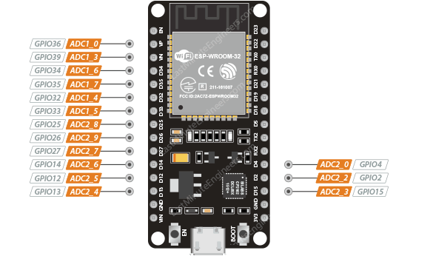
Microcontroller
Depending on the individual watch brand and model, a smartwatch's microprocessor can change. The ARM Cortex-M series and the STMicroelectronics STM32 series are two prominent microcontrollers found in smartwatches. A bespoke Apple S7 processor built on the ARM Cortex-M architecture, for instance, is used in the Apple Watch Series 7's SiP (System in Package). Similar to this, Samsung Electronics' Exynos W920, a CPU designed exclusively for wearables and based on the ARM Cortex-M architecture, powers the Samsung Galaxy Watch 4. Various microcontrollers may be used by other smartwatches, depending on their individual needs and design factors. The final decision on the microcontroller will be based on elements like the needed performance, power consumption, and price

Slide 11
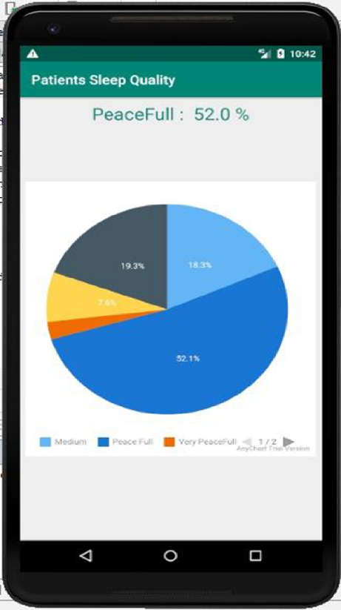
Mobile application
A tiny Android app that displays a patient's current sleep quality status will be created. This app makes it easier to see the patient's sleep quality
It will be simple to determine the patient's general sleep condition thanks to calculated findings that the app may retrieve and display in a pie chart.

Slide 12
Literature survey
S.N. | Title | Summery
1. | Sleep Monitoring Systems: Current Status and Future Challenges | The article highlights the accuracy and practicality issues with current sleep monitoring methods and calls for the development of new monitoring technologies, standardization of measurement techniques, increased collaboration, and more research into the relationship between sleep and health.
2. | A Real-Time Sleep Monitoring System with a Smartphone | The study describes a real-time sleep monitoring system using a smartphone's sensors and machine learning algorithms to track sleep patterns and stages, addressing the shortcomings of existing technology.

Slide 13
S.N. | Title | Summery
3. | Internet of Things for Sleep Quality Monitoring System: A Survey | The study reviews the use of the Internet of Things (IoT) for sleep quality monitoring, discussing sensor technology, data analytics, privacy and security concerns, and proposes combining sensors with data analytics techniques to improve precision.
4. | Development of a sleep monitoring system with wearable vital sensor for home use | The study aims to develop a wearable home sleep monitoring system to enhance sleep quality and identify sleep disorders, utilizing a wearable sensor to measure vital signs and evaluating challenges in creating such a system.

Slide 14
S.N. | Title | Summery
5. | Nonconstrained Sleep Monitoring System and Algorithms Using Air-Mattress with Balancing Tube Method | The study presents a non-invasive sleep monitoring system using an air-mattress with advanced algorithms to gather data on heart rate, breathing rate, body movements, and sleep stages, showing high accuracy compared to polysomnography.
6. | Development and Preliminary Validation of Heart Rate and Breathing Rate Detection Using a Passive, Ballistocardiography-Based Sleep Monitoring System | The paper describes a passive sleep monitoring system using a pressure-sensitive pad under the mattress to detect ballistocardiographic signals, providing accurate heart rate and breathing rate detection compared to polysomnography.

Slide 15
S.N. | Title | Summery
7. | Long-term Sleep Monitoring System and Long-term Sleep Parameters using Unconstrained Method | The study presents a long-term sleep monitoring system using a bed-based sensor system to detect body movements, respiratory signals, and heart rate, accurately measuring sleep parameters over extended periods of time.
8. | Validation of Sleep-Tracking Technology Compared with Polysomnography in Adolescents | The study compares the accuracy of sleep-tracking technology with polysomnography in teens, highlighting the limitations of sleep monitoring technologies and the need for improvement.

Slide 16
S.N. | Title | Summery
9. | Sleep tracking in the real world: a qualitative study into barriers for improving sleep | The qualitative study investigates challenges associated with using sleep-tracking technology to improve sleep, emphasizing accuracy, reliability, and the need for behavioral changes.
10. | Pajama’s, Polysomnography and Professional Athletes: The Role of Sleep Tracking Technology in Sport | The paper discusses the use of sleep tracking technology in professional athletes, highlighting its benefits in optimizing recovery, improving performance, and addressing challenges such as data accuracy and privacy.

Slide 17
S.N. | Title | Summery
11. | How Does Sleep Tracking Influence Your Life? | The study explores how sleep monitoring technologies affect behavior and perceptions of sleep, demonstrating improved awareness and behavior changes but also concerns around data privacy and accuracy.
12. | The Design and Realization of Sleep-monitoring System Based on Body-movement Signals | The paper proposes a non-invasive sleep monitoring system using body movement signals and an algorithm based on Fast Fourier Transform and linear discriminant analysis, demonstrating accurate sleep stage classification.

Slide 18
S.N. | Title | Summery
13. | High-Performance and Resource-Efficient IoT-based Sleep Monitoring System | The paper describes a resource-efficient IoT-based sleep monitoring system that accurately identifies sleep stages and related events, showcasing potential for real-world sleep monitoring and management.
14. | An unobtrusive sleep monitoring system for the understanding of human sleep behavior | The study presents an inconspicuous sleep monitoring system using a bed sensor and a smartphone application to gather sleep-related body movements and self-reported data, providing insights into sleep behavior and potential disorders.

Slide 19
S.N. | Title | Summery
15. | A survey on sleep assessment methods | The literature review summarizes and compares sleep assessment methods, categorizing them based on accuracy and discussing the limitations and advantages of subjective and objective techniques.
16. | Assistive technology to enable sleep function in patients with acquired brain injury: Issues and opportunities | The article suggests different treatments for sleeping difficulties in patients with brain injury, including CPAP therapy, light therapy, and cognitive behavioral therapy.

Slide 20
S.N. | Title | Summery
17. | Non-invasive analysis of sleep patterns via multimodal sensor input | The study uses Microsoft Kinect and a bed pressure mat sensor to examine sleep habits, gathering information on sleep patterns and activities to provide a comprehensive analysis.
18. | Validation of a Consumer Sleep Wearable Device with Actigraphy and Polysomnography in Adolescents Across Sleep Opportunity Manipulations | The research validates a consumer sleep wearable device for monitoring sleep stages and parameters in adolescents, highlighting its accuracy for certain measurements but cautioning against sole reliance on its results.

Slide 21
S.N. | Title | Summery
19. | A system, method, and item for stress reduction and sleep promotion | The patent describes a system for reducing stress and promoting sleep, incorporating temperature regulation and additional components like a pulsed electromagnetic frequency device.
20. | Bed with mattress and foot warming system | The patent presents a bed design with a foot warming system, utilizing a heating unit and an envelope for temperature control.

Slide 22
Related work
There are four categories, in which we can classify modern sleep monitoring technologies, currently under study.
Sleep monitoring
Brain activity
Bed Based
Movement based
Autonomic signals

Slide 23
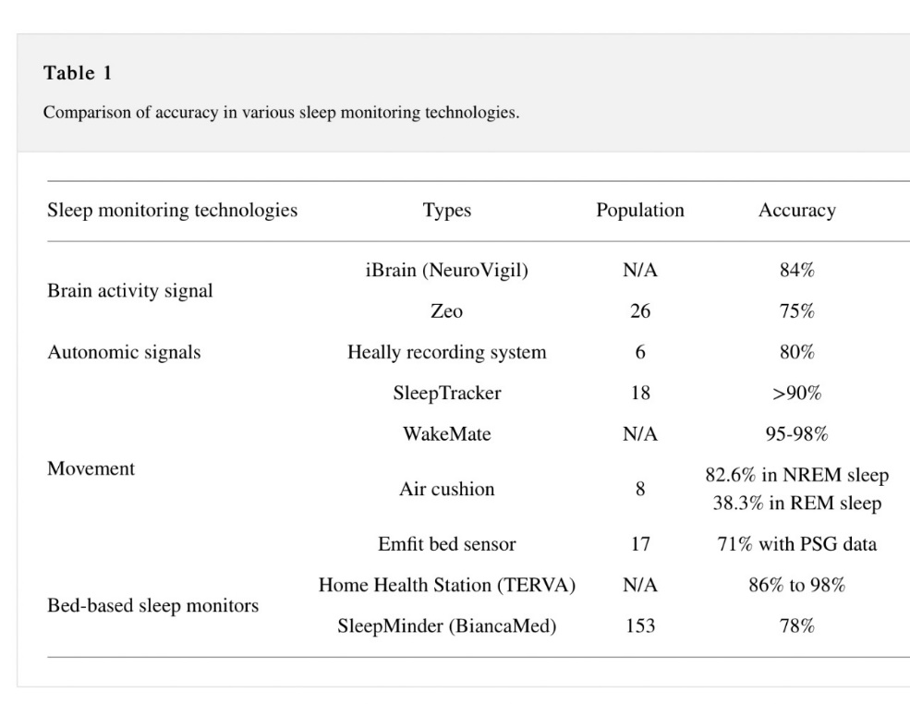
Existing system
Several devices are also available which are currently used for sleep evaluation at home as shown in Table. Many of these are accessible in the market for purchase. The following table shows the comparison between various sleep monitoring devices where REM (rapid eye movement) and NREM (nonrapid eye movement) are sleep stages.

Slide 24
Problems in existing system
More focused on providing the assistance to guide the user to get relaxed while sleeping using various attachments.
Not focused monitors the real time health related parameters of the user while they take nap and does not provide the user with favorable ambient conditions and no means to determine their real time location at the time of nap.
All the existing system is based on sleep monitoring. They do not provide a proper solution or a routine to be followed.

Slide 25
Market survey
Survey was created online through goggle forms.
In our survey persons from every age group participated but our main target audience was persons of age group between 18 to 30 years.
Survey questions
Do you know about Insomnia?
Have you ever felt sleeplessness?
If yes than what measures did you take to overcome it?
Do you wish a device that will track your sleeping activities and provide you a proper routine for healthy sleep?
What valuable feature will you suggest to be added in that sleep monitoring system?

Slide 26
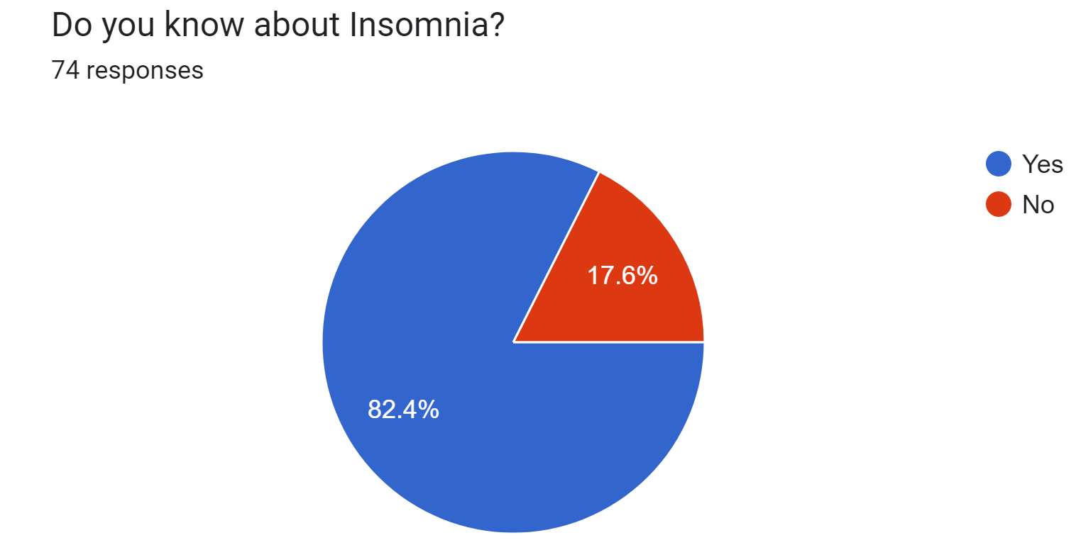
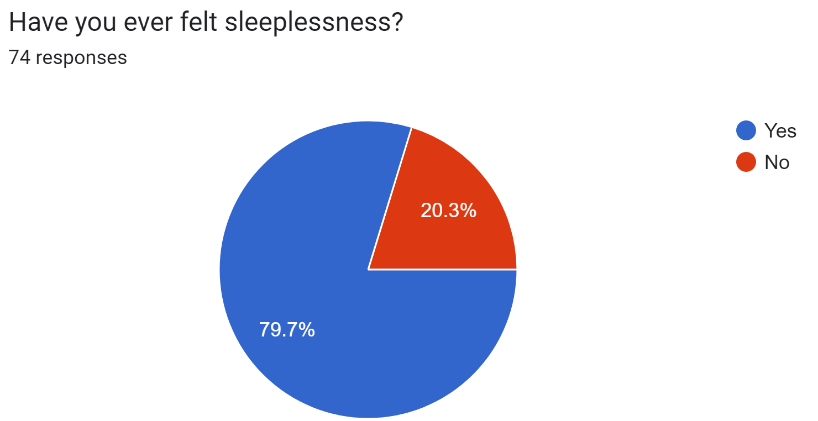
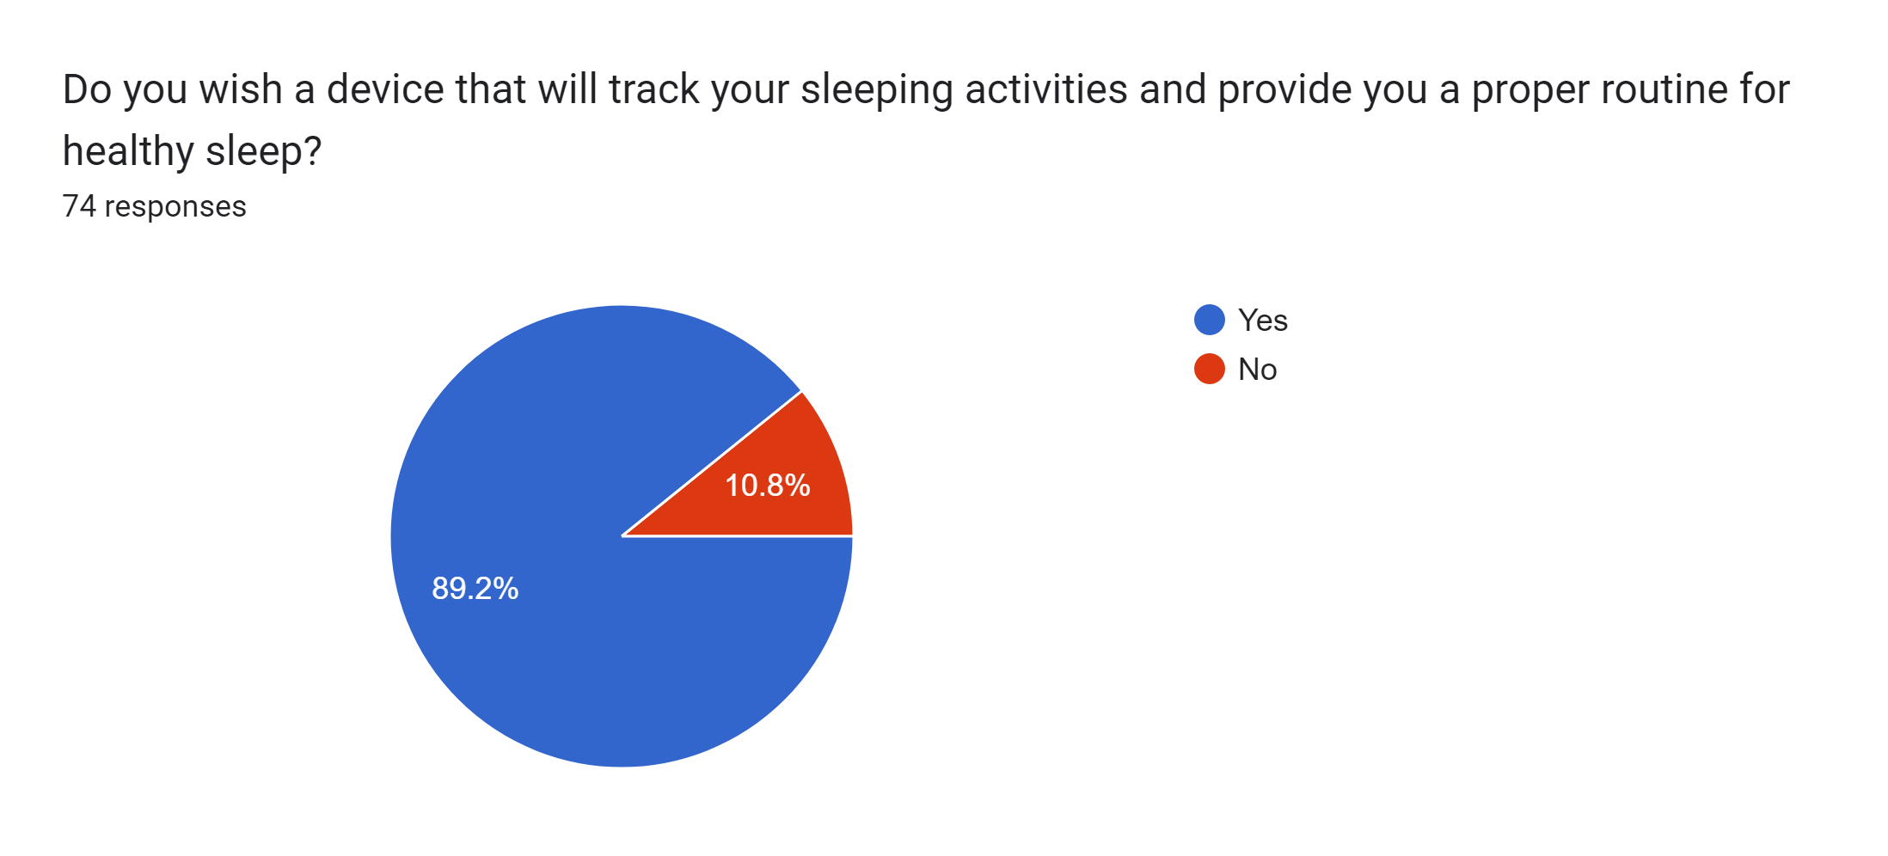
responses

Slide 27


Try to improve my sleeping routine
Music, meditation
Medicine, proper diet, follow time table
Drinking lots of water
One sheep, two sheep
Study my medicine books.
I did pranayam and them slept
Drank lots of water. Removed all the electronic devices from my side.
Try to watch movies
Exercise, Reducing Stress
Therapy and pills
Try hard to sleep, empty my mind and blink my eyes. If these does
Washing face , seeing horror movies
Counting sheeps
Initially I reduced my screen time. After 8pm, no more screen time. No mobiles and laptops. That helped a lot
Peaceful tune should be given in order to do keep mind meditate & silence
That sleep monitoring device must track the active sleepness period of time as well as track and notify about the reason why we dont get sleep if possible!
Detect interrupted sleep
To suggest tips for maintain a healthy sleep cycle and measures to be taken to induce sleep
Some kind of peaceful music could be added too
Daly routine alarm for sleep and everything and easy to use
Heart and blood pressure monitor
Louder alarm clock.
Remind user to sleep in time to complete sleep cycle.
Set a goal
To Monetize Weekly Basis Time Duration of Sleeping Time.
How much time we will take get a deep sleep
The device algorithm should be offline and data shouldn't leave my device.
Active body and body movement tracking, in-depth summary of the sleep activity. The app should not conclude the sleep time rather it should leave the user an optional report of the sleep time, (when the device/app is unable to detect the sleep of the user) where the user can select all the time slots he was actually asleep.
Snore tracking

Slide 28
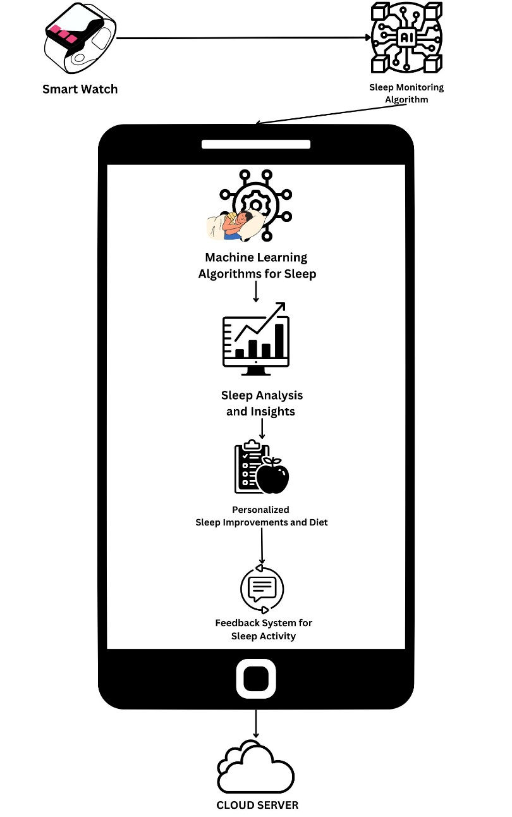
Proposed system
The components in the System are :
Smartwatch
Sleep Monitoring Algorithm
Machine Learning Algorithms
Sleep Analysis and Insights
Personalized Sleep Improvements and Diet
Feedback System for Sleep Activity
Sleep Data Storage

Slide 29
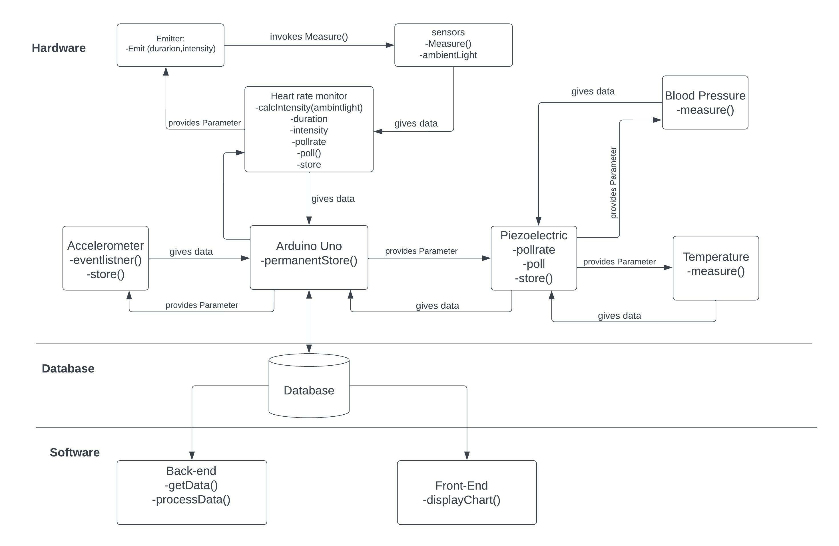
System architecture

Slide 30
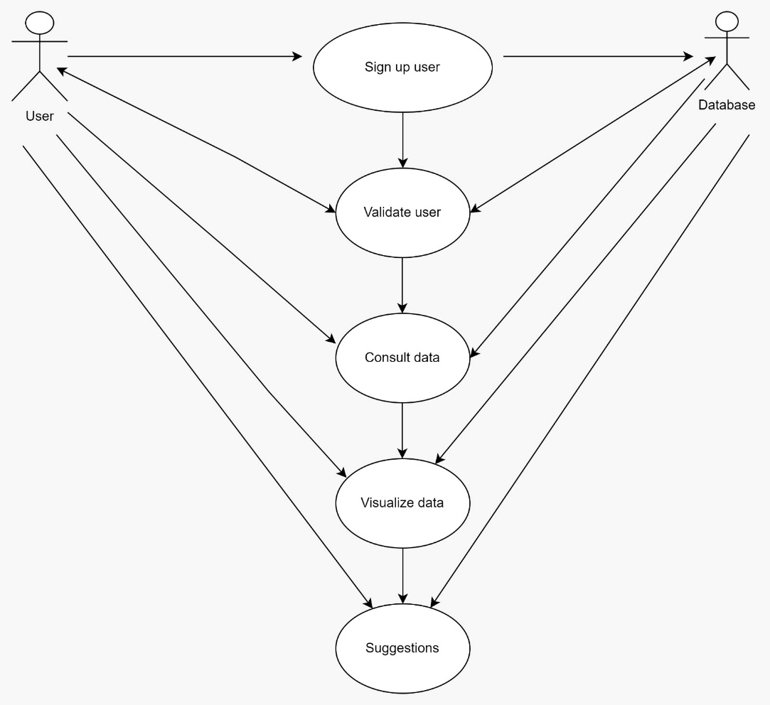
Use case diagram

Slide 31
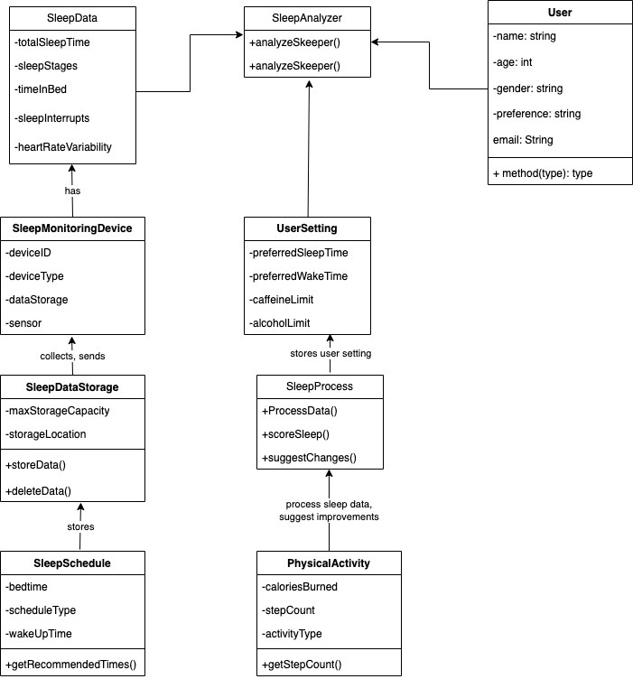
Class Diagram

Slide 32
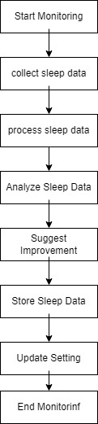
Activity diagram

Slide 33
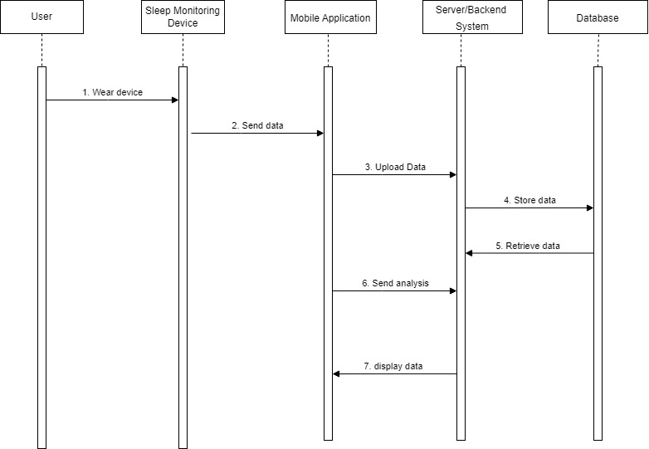
Sequence Diagram

Slide 34
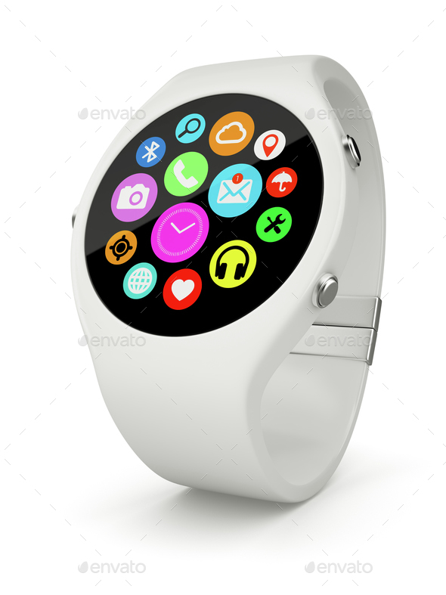
Implementation

Slide 35
conclusion
In conclusion, a sleep monitoring system that uses a smartwatch and machine learning algorithms can provide users with valuable insights into their sleep patterns and recommendations for improving their sleep quality. By collecting data on sleep duration, sleep quality, and other sleep-related metrics, the system can provide personalized insights into sleep patterns, such as when the user is most likely to wake up and how often they wake up during the night. Machine learning algorithms can then analyze this data and provide tailored recommendations for improving sleep, such as adjusting sleep schedules or changing sleeping positions. Additionally, by including a feedback system that provides suggestions on sleep activity and diet, the system can provide users with a comprehensive set of recommendations for improving their overall health and well-being. For people wishing to enhance their sleep quality and general health, a sleep monitoring system that makes use of a smartwatch and machine learning algorithms has the potential to be an effective tool. With the right design and implementation, such a system can provide users with valuable insights and personalized recommendations, ultimately leading to better sleep and a better quality of life.

Slide 36
references
Ibáñez V, Silva J, Cauli O. A survey on sleep assessment methods. PeerJ. 2018 May 25;6:e4849. doi: 10.7717/peerj.4849. PMID: 29844990; PMCID: PMC5971842.
Biajar, Anmol, Tatyana Mollayeva, Sandra Sokoloff, and Angela Colantonio. “Assistive Technology to Enable Sleep Function in Patients with Acquired Brain Injury: Issues and Opportunities.” British Journal of Occupational Therapy 80, no. 4 (April 2017): 225–49. https://doi.org/10.1177/0308022616688017.
Metsis, V., Kosmopoulos, D., Athitsos, V. et al. Non-invasive analysis of sleep patterns via multimodal sensor input. Pers Ubiquit Comput 18, 19–26 (2014). https://doi.org/10.1007/s00779-012-0623-1
Lee XK, Chee NIYN, Ong JL, Teo TB, van Rijn E, Lo JC, Chee MWL. Validation of a Consumer Sleep Wearable Device With Actigraphy and Polysomnography in Adolescents Across Sleep Opportunity Manipulations. J Clin Sleep Med. 2019 Sep 15;15(9):1337-1346. doi: 10.5664/jcsm.7932. PMID: 31538605; PMCID: PMC6760396.
Ronald Stuart BENSON, Ryan Cameron DENOMME. Sleep monitoring system (2018) U.S. Pat. No.10874350B2
Todd Youngblood, Tara Youngblood Stress reduction and sleep promotion system (2021) U.S. Pat No.11013883B2
Kody Lee Karschnik, Omid Sayadi, Wade Daniel Palashewski, Ramazan Demirli, Eric Rose, Saurabh Chhaparwal Bed with foot warming system (2020) U.S. Pat No. 20210289947A1.
PAN, Qiang & Brulin, Damien & Campo, Eric. (2020). Sleep monitoring systems: Current status and future challenges (Preprint). JMIR Biomedical Engineering. 5. 10.2196/20921.
T. -Y. Han, S. -D. Min and Y. Nam, "A Real-Time Sleep Monitoring System with a Smartphone," 2015 9th International Conference on Innovative Mobile and Internet Services in Ubiquitous Computing, Santa Catarina, Brazil, 2015, pp. 458-461, doi: 10.1109/IMIS.2015.69.
N. Surantha, G. P. Kusuma and S. M. Isa, "Internet of things for sleep quality monitoring system: A survey," 2016 11th International Conference on Knowledge, Information and Creativity Support Systems (KICSS), Yogyakarta, Indonesia, 2016, pp. 1-6, doi: 10.1109/KICSS.2016.7951426.
Suzuki, Takuji & Ouchi, Kazushige & Kameyama, Ken-Ichi & Takahashi, Masaya. (2009). Development of a Sleep Monitoring System with Wearable Vital Sensor for Home Use.. 326-331.
Nonconstrained Sleep Monitoring System and Algorithms Using Air-Mattress With Balancing Tube Method. (2010, January 1). IEEE Journals & Magazine | IEEE Xplore. https://ieeexplore.ieee.org/stamp/stamp.jsp?tp=&arnumber=5290162&tag=1

Slide 37
Development and Preliminary Validation of Heart Rate and Breathing Rate Detection Using a Passive, Ballistocardiography-Based Sleep Monitoring System David C. Mack, James T. Patrie, Paul M. Suratt, Robin A. Felder, and Majd Alwan, Senior Member, IEEE https://ieeexplore.ieee.org/stamp/stamp.jsp?tp=&arnumber=4663856
Promises and Challenges in the Use of Consumer-Grade Devices for Sleep Monitoring Sirinthip Roomkham , David Lovell , Joseph Cheung , and Dimitri Perrin. https://ieeexplore.ieee.org/stamp/stamp.jsp?tp=&arnumber=8309286
Long-term Sleep Monitoring System and Long-term Sleep Parameters using Unconstrained Method Jaehyuk Shin, Youngjoon Chee, and Kwangsuk Park, Member, IEEE https://citeseerx.ist.psu.edu/document?repid=rep1&type=pdf&doi=7bb91d3bbf05f30ba1dcaa7d4ebf9ffb0c7042f9
de Zambotti M, Baker FC, Colrain IM. Validation of Sleep-Tracking Technology Compared with Polysomnography in Adolescents. Sleep. 2015 Sep 1;38(9):1461-8. doi: 10.5665/sleep.4990. PMID: 26158896; PMCID: PMC4531414.
Zilu Liang and Bernd Ploderer. 2016. Sleep tracking in the real world: a qualitative study into barriers for improving sleep. In Proceedings of the 28th Australian Conference on Computer-Human Interaction (OzCHI '16). Association for Computing Machinery, New York, NY, USA, 537–541. https://doi.org/10.1145/3010915.3010988
Driller, M. W., Dunican, I. C., Omond, S. E. T., Boukhris, O., Stevenson, S., Lambing, K., & Bender, A. (2023). Pyjamas, Polysomnography and Professional Athletes: The Role of Sleep Tracking Technology in Sport. Sports, 11(1), 14. https://doi.org/10.3390/sports11010014
Kuosmanen, E., Visuri, A., Kheirinejad, S., Van Berkel, N., Koskimäki, H., Ferreira, D., & Hosio, S. (2022). How Does Sleep Tracking Influence Your Life? Proceedings of the ACM on Human-computer Interaction, 6(MHCI), 1–19. https://doi.org/10.1145/3546720
Y. Wei et al., "The Design and Realization of Sleep-monitoring System Based on Body-movement Signals," 2019 2nd International Conference on Safety Produce Informatization (IICSPI), Chongqing, China, 2019, pp. 533-536, doi: 10.1109/IICSPI48186.2019.9096055.
N. Surantha, O. K. Utomo and S. M. Isa, "High-Performance and Resource-Efficient IoT-based Sleep Monitoring System," 2020 IEEE 91st Vehicular Technology Conference (VTC2020-Spring), Antwerp, Belgium, 2020, pp. 1-5, doi: 10.1109/VTC2020-Spring48590.2020.9129521.
P. Barsocchi, M. Bianchini, A. Crivello, D. La Rosa, F. Palumbo and F. Scarselli, "An unobtrusive sleep monitoring system for the human sleep behaviour understanding," 2016 7th IEEE International Conference on Cognitive Infocommunications (CogInfoCom), Wroclaw, Poland, 2016, pp. 000091-000096, doi: 10.1109/CogInfoCom.2016.7804531.
S. T. -B. Hamida and B. Ahmed, "A remote deep sleep monitoring system based on a single channel for in-home insomnia diagnosis," 2015 7th International Conference on New Technologies, Mobility and Security (NTMS), Paris, France, 2015, pp. 1-2, doi: 10.1109/NTMS.2015.7266469.
Survey form link : https://forms.gle/pmdy45LKJJ6htHd19
Resposes of the survey : https://docs.google.com/spreadsheets/d/1U6WLk7Ne0LV79moamtNjVPHlrR2nn_6hfSQIf1csSro/edit?usp=sharing

Slide 38
THANK YOU
Submitted by :
SACHIN SINGH
20BTRCS170
AAYUSHMA THAPA
20BTRSE072
MANISH YADAV
20BTRSE037
PRIYANKA KUMARI
20BTRCO072
PREETI KURMI
20BTRCO071
Under the guidance of
Mr. Santhosh S

